Slide 1
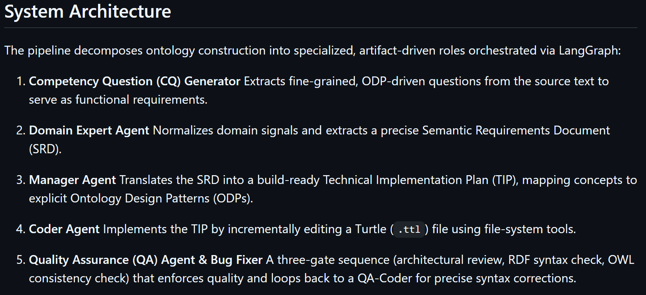
Based on:
https://github.com/brains-group/towards_automated_ontology_generation
Applied to the NBN Wholesale Broadband Agreement (WBA) documents · model: DeepSeek V4 Flash
Notes:
This is the repo we are reproducing: a pipeline of five roles (question writer, domain expert, manager, coder, QA) that turns a PDF into an OWL/Turtle ontology page by page. The next slide explains it in plain words.

Slide 2
The paper's pipeline in plain words
PDF page
① Question writer
CQ generator
② Analyst
Domain Expert → SRD
③ Architect
Manager → TIP
④ Builder
Coder (edits file)
⑤ Inspector
QA + QA-Coder
ontology.ttl
output
One page of the document at a time
Writes test questions with the right answers, e.g. “Max NNI Bearers in a group?” → 8
Lists the concepts, links and numbers needed to answer the questions
Plans how to model them with standard design patterns (ODPs)
Writes the Turtle (.ttl) triples into the ontology file
Three gates: design review, syntax check, logic (OWL) check. Sends fixes back
Grows page by page. The whole file is pasted into every prompt
Think of a small team: a question-writer, an analyst, an architect, a builder and an inspector, passing a document to each other.
Then it is tested (evaluation)
An LLM writes a SPARQL query for each question, the query runs on the ontology, and a judge scores the answer from 0 to 1. The average is the “CQ coverage”.
Paper vs this project
Paper: 2 life-insurance contracts, a 30B local model, starts from an empty file.
Here: NBN WBA documents, DeepSeek V4 Flash, starts from Farzad's reference ontology.
Notes:
Source: the paper, section 3.3 (multi-agent generator) and 3.4 (evaluation). Each page goes through the five roles. SRD = Semantic Requirements Document, TIP = Technical Implementation Plan, ODP = Ontology Design Pattern.

Slide 3
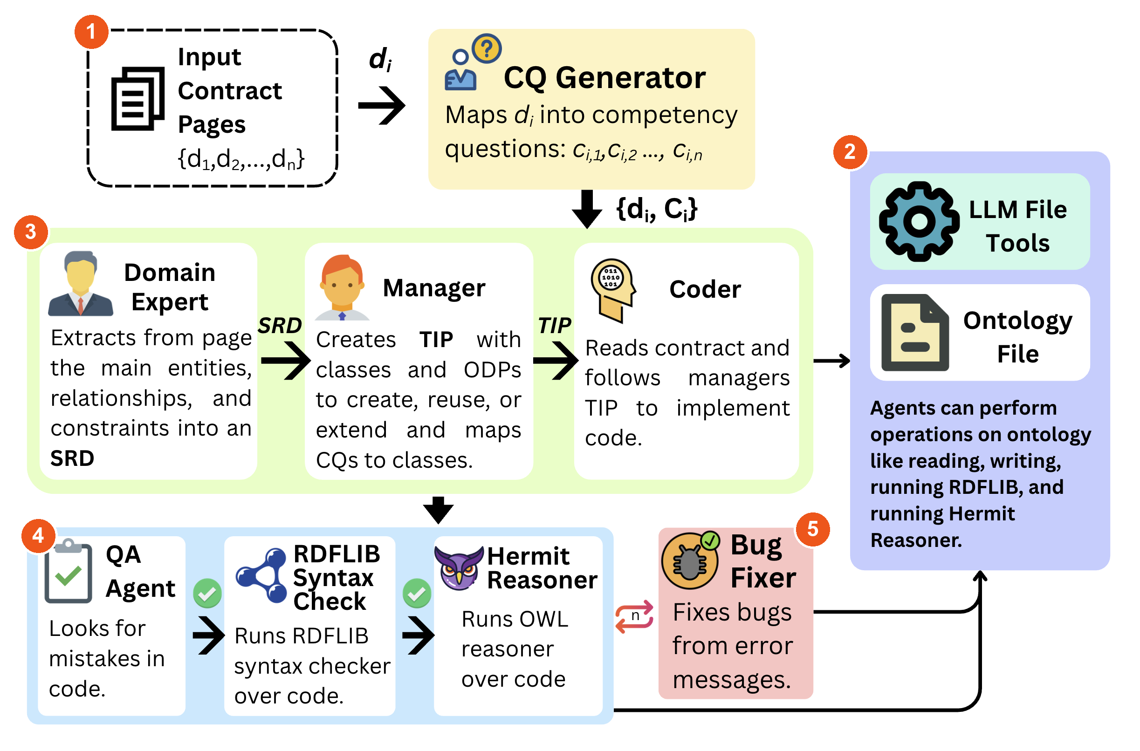
The paper's Figure 2, with our five differences
1 Only the 51 key pages of the 4 documents are used (of 188).
2 The ontology file starts from Farzad's reference ontology, not empty. New terms are tagged, every fact carries a source clause.
3 The reference rules and term list are added to every agent's prompt.
4 The QA review runs as plain code (numbers on the page, duplicates, source clause, CQ answered), not an LLM. RDFLib and HermiT checks stay.
5 Repair is capped at 3 rounds, then the file is restored and the page dropped (paper: up to 1,000 cycles).
Everything else is the paper's pipeline: CQ Generator, Domain Expert, Manager, Coder, file tools, RDFLib, HermiT, Bug Fixer.
Notes:
The figure is the paper's Figure 2 (page 7 of the PDF), unchanged, with five numbered badges. 1 page selection, 2 reference ontology seeded into the file, 3 reference brief in every agent's prompt, 4 deterministic checks instead of the LLM QA agent (the 'lite' loop), 5 bounded repair (3 rounds, then restore + drop page). Source: Presentation/annotate_paper_figure.py. A more detailed drawing is in assets/pipeline_comparison.png.

Slide 4
What had to be added
Where the implementations differ
The reference: Farzad's ontology (dart-project-main in Documents) is the NBN “skeleton”: NNI Group, CVC, AVC, Bearer, POI, Service Level…
We give the model 24 classes, 73 properties and 30 fixed values from it (Single / Diverse Chassis, 1 / 10 / 100 Gbps…).
Why: the original repo starts from an empty file, so the model invents its own names. Now it must reuse these, and may add new things from the PDFs only if they are tagged with document + page.
helper/reference.py (new): loads the reference, writes it into the file, builds the text the agents get
agents/multi_agent.py (+235 / −29 lines): sends that text to all 5 agents, seeds the file, adds the “lite” checks
helper/grounding.py (new): checks every number against the PDF page
Exact code on the next slides →
Notes:
The repo's other edited files are small fixes (Windows paths, OpenRouter endpoint, missing helper functions, two bugs) - listed in REPRODUCTION.md. Everything about the reference ontology is in the three files above.

Slide 5
How the reference reaches the LLM
dart_core.ttl
Farzad's ontology
24 classes · 73 properties
① Seed the file
Writes the skeleton into ontology.ttl before page 1. The original starts from an empty file.
ontology.ttl · REFERENCE SEED
do not delete
617 triples from Farzad
The 5 agents read and write this file
Expert · Manager · Coder · QA · QA-Coder
each prompt now ends with the brief
② Brief the agents
Adds the rules + a term list (class · also called · properties) to the prompt of all 5 agents.
reference.py
Reference class
③ Check the result
New things must carry [extension: document, page]; every fact must carry :sourceClause.
EXTENSIONS FROM DOCUMENTS
new classes, properties, facts
each with page + source
A real fact from the result (Technical Specification), with the page it came from:
:BearerLimit_1G_10G_Max8 a :Cl_BearerLimit, owl:NamedIndividual ;
rdfs:label "Bearer Limit: 8 NNI Bearers for 1Gbps and 10Gbps" ;
:hasCondition :Cond_1G_10G ;
:hasMaxBearers 8 ;
:hasUnit "NNI Bearers"^^xsd:string ;
:sourceClause "Wholesale Broadband Agreement - Product Technical Specification - nbn Ethernet Product Module, section 6.1, page 28" .
Notes:
Mechanically: the file is seeded once (lines 1060-1070 of multi_agent.py), the same text is appended to each agent's prompt (five one-line calls), and the extension tags let us tell Farzad's terms from the ones the PDFs added.

Slide 6
Code 1 — the rules every agent receives
helper/reference.py (long lines cut with … ; the file has the full text)
241 _POLICY = (
242 "REFERENCE ONTOLOGY (authoritative starting vocabulary)\n"
243 "The ontology file already contains the reference schema between the REFERENCE SEED…
244 "1. REUSE: when the text refers to a concept that matches a reference class, proper…
245 "'also called' name - use that reference term exactly (same IRI). Never create a du…
246 "2. EXTEND: the documents may state things the reference lacks (new defined terms, …
247 "obligations, limits, conditions, exceptions). ADD them below the EXTENSIONS marker…
248 "reference class with rdfs:subClassOf / rdfs:subPropertyOf. Every NEW class or prop…
249 "with `[extension: <document name>, <clause or page>]`.\n"
250 "3. FACTS: represent every contract fact (numbers, rates, percentages, charges, dur…
251 "limit is a data-property value on an individual of the governed class (a property …
252 "that depends on rate, mode or product is one individual per condition carrying the…
253 "ISO-8601 durations). Add `:sourceClause \"<document>, <clause>, p.<page>\"` to eve…
254 "4. NEVER delete or weaken reference axioms. If the document disagrees with a refer…
255 "document's value as its own fact with its :sourceClause and add `rdfs:comment \"[c…
256 "5. Only instantiate reference concepts the document actually talks about; do not i…
257 )
270 def prompt_block(self, role: str) -> str:
271 parts = ["\n\n" + self._POLICY]
272 if role in ("expert", "manager"):
273 parts.append("REFERENCE VOCABULARY (class (is-a) | also called | properties):\n…
274 parts.append(self._ROLE.get(role, ""))
275 return "\n".join(p for p in parts if p) + "\n"
In simple words
1 REUSE If the PDF says “NNI Group”, use the existing NNIGroup. No copies.
2 EXTEND New things are allowed, but tagged [extension: doc, page].
3 FACTS Numbers become data, each with :sourceClause (where it came from).
4 NEVER delete If the PDF disagrees with the reference, keep both and flag it.
5 No inventing.
prompt_block() glues the rules to a short per-role sentence (_ROLE) and, for the Expert and Manager, the term list.
Notes:
These are lines 241-257 and 270-275 of helper/reference.py. The text is plain English because the agents are LLMs: it is a prompt, not logic. An earlier version of rule 3 contained a real value from the PDFs (4000) as an example; that leaked an answer to one of our test questions and was removed.

Slide 7
Code 2 — plugging it into the original pipeline
agents/multi_agent.py (yellow ◂ labels added for the slide)
24 from helper.reference import Reference
56 REF = None # helper.reference.Reference when --reference is given
64 def _ref_block(role: str) -> str:
65 """Reference-ontology guidance for an agent role ('' when no reference is…
66 return REF.prompt_block(role) if REF is not None else ""
266 human += _ref_block("expert") ◂ Domain Expert
371 f"{_ref_block('manager')}\n" ◂ Manager
477 {_ref_block('coder')} ◂ Coder
599 + _ref_block("qa") ◂ QA reviewer
829 system_prompt += _ref_block("qa_coder") ◂ QA-Coder
1026 if args.reference:
1027 REF = Reference(args.reference, args.reference_scope)
…
1069 else:
1070 ontology_file_path.write_text(REF.seed_turtle(), encoding="utf-8")
In simple words
5 one-line insertions — one per agent. Each adds the brief to that agent's prompt.
1 new command-line flag, --reference, loads the ontology.
2 lines write the seed into the file, only if the file is still empty (never overwrites work).
How we start it:
--arm reference --reference-scope core --mode lite
Without --reference nothing changes: it is still the paper's pipeline.
Notes:
Line numbers are from the current agents/multi_agent.py. The code lines are cut straight out of the file; only the yellow ◂ labels were added here to say which agent each line belongs to.

Slide 8
Code 3 — “lite” checks instead of an LLM reviewer
④ Builder
writes the page into the file
Checks (no LLM)
numbers · duplicates · sources · answers · cycles
all pass
Next page
all checks pass
Still wrong?
wrong numbers deleted; broken page dropped
problem → feedback, max 2 rounds
helper/grounding.py — what the checks tell the Coder
205 def build_feedback(base, now, page_text, cqs, seed_individuals=frozenset(), …
206 fb = []
207 for cyc in subclass_cycles(base, now):
208 a, b = cyc
209 fb.append(f"CIRCULAR HIERARCHY: {local(a)} rdfs:subClassOf {local(b)…
210 f"statement '{local(a)} rdfs:subClassOf {local(b)}' that y…
211 for s, p, v, kind in ungrounded_literals(base, now, page_text):
212 fb.append(f"UNSUPPORTED VALUE: {local(s)} {local(p)} \"{v[:80]}\" is…
213 f"value the page text actually states (use grep_file for '…
214 for kind, new, old in duplicates(base, now):
215 fb.append(f"DUPLICATE {kind.upper()}: {local(new)} repeats the exist…
216 f"everywhere instead (grep_file for '{local(new)}').")
217 for s, p in reference_contamination(base, now, seed_individuals):
218 fb.append(f"REFERENCE INDIVIDUAL MODIFIED: {local(s)} is a reference…
219 for s in individuals_without_source(base, now):
220 fb.append(f"NO SOURCE: individual {local(s)} has values but no :sour…
221 for cq in uncovered_cqs(cqs, now):
222 fb.append(f"UNCOVERED QUESTION: \"{cq['competency_question'][:140]}\…
223 f"ontology. If the page states it, add it as a fact with :…
224 return fb[:limit]
the number check, then the last-resort clean-up
68 nums = [float(x) for x in re.findall(r"\d+(?:\.\d+)?", v.r…
69 if nums:
70 return all(n in page.nums for n in nums)
71 return None
1159 if PIPELINE_MODE == "lite" and PAGE_BASE is not No…
1160 try:
1161 removed = grounding.strip_ungrounded(ontol…
1162 if removed:
1163 print(f"[stripped] page={page_number +…
Notes:
Why: the paper's LLM review loop is expensive and can loop for a very long time. In our first test the QA loops used ~1.4M tokens for 2 pages. The lite checks are plain Python, free, and stricter on numbers: a value that is not on the page is deleted. (Line numbers: grounding.py 205-224 build_feedback; 68-71 the numeric check; multi_agent.py 1159-1163 the strip_ungrounded call.)

Slide 9
Exactly which documents and pages
Document (nbn Ethernet …) | Pages | In the ontology (PDF page numbers) | Not in, and why
Product Technical Specification | 84 | 5–6, 10, 24–31, 33, 38–40, 42–44, 50, 52, 64, 79 | 32, 41, 51: failed (file error / repair rounds used up)
Product Description | 32 | 6–8, 10, 13, 15, 18–19, 21, 26 | 9: ran, added nothing
Price List | 22 | 5–7, 9–11, 18–20 | 8: failed (file error)
Service Levels Schedule | 50 | 13, 15, 33–35 | –
How the pages were chosen: each page is scored by how often it mentions the reference concepts (NNI Group, Bearer Limit, CVC, AVC, Product Component, TC-1/2/4, Network Availability, frame delay…). Score ≥ 25 → important. That gave 51 pages out of 188 in these 4 documents; 50 other PDFs (letters, annexures, other products) are not used.
Fair Use Policy (8 pages) was only used for a first test; it is not in this ontology.
Notes:
Page numbers are PDF page numbers (page 1 = cover). 'Ran, added nothing' means the agent finished without writing any new triples (Product Description page 9). 'Failed' means the page could not be repaired and was rolled back.

Slide 10
Accuracy & metrics
How accurate is it? Numbers, dates and durations are checked against the text of their own page; 73 that were not on the page were deleted (Price List excluded, see the last slide). SPARQL + judge test (paper's method): 186 of 240 sampled questions fully correct.
How specific? Each limit keeps its condition, value, unit and source, e.g. “Bearer Limit: 8 NNI Bearers for 1G/10G · section 6.1 · page 28”. So far, merged: 351 new classes, 651 new properties and 1239 facts.
What is included / left out? Included: 4 documents, 46 key pages of the 51 chosen (out of 188 pages). Left out: 4 pages that failed, 1 that added nothing, and the other 50 PDFs. Price List facts mostly lack a source clause (bug, slide 'Known problems').
46 / 51
key pages in the ontology
72%
facts with a source clause
186 / 240
test questions fully correct
32
near-duplicate class pairs
Notes:
Numbers come from the files at build time. 'Accurate' here means two things: (1) values are on the source page (automatic check), (2) the paper's SPARQL + LLM-judge test on a sample. It does not mean a human has reviewed the ontology.

Slide 11
Quality and competency questions (CQs) per document
Document | New classes | New props | Facts | Facts with source | CQs on pages used | …numeric answers | Answer in ontology*
Technical Specification | 179 | 349 | 597 | 529 (89%) | 377 | 176 | 377 / 377
Product Description | 65 | 150 | 257 | 218 (85%) | 142 | 71 | 142 / 142
Price List | 76 | 114 | 332 | 67 (20%) | 147 | 107 | 147 / 147
Service Levels | 47 | 72 | 80 | 80 (100%) | 95 | 48 | 92 / 95
All four, merged | 351 | 651 | 1239 | 891 (72%) | 761 | 402 | 758 / 761
Read this carefully
* “Answer in ontology” is a loose check: the expected answer's words/numbers appear somewhere in the ontology. The build loop itself pushes for this, so it is optimistic. The real test is the SPARQL + judge score (next slides).
Duplicate-looking classes: 32 pairs (e.g. Cl_AVC next to AVC). 61 facts are named *_Example. Merged = a term found in two documents is counted once.
What a CQ looks like
Q: What is the Bearer Limit for an NNI Group of 2 × 100 Gbps NNI Bearers in Diverse Chassis mode?
A: 31,000
CQs are written from the PDF page by the question-writer agent (the paper's step 1); they are the test and the to-do list for each page.
Notes:
Facts = individuals (data about specific things) added by the documents, not counting Farzad's own 30 values. Price List: facts without a source clause are a known bug (a namespace mismatch made the check delete the clauses), see 'Known problems'.

Slide 12
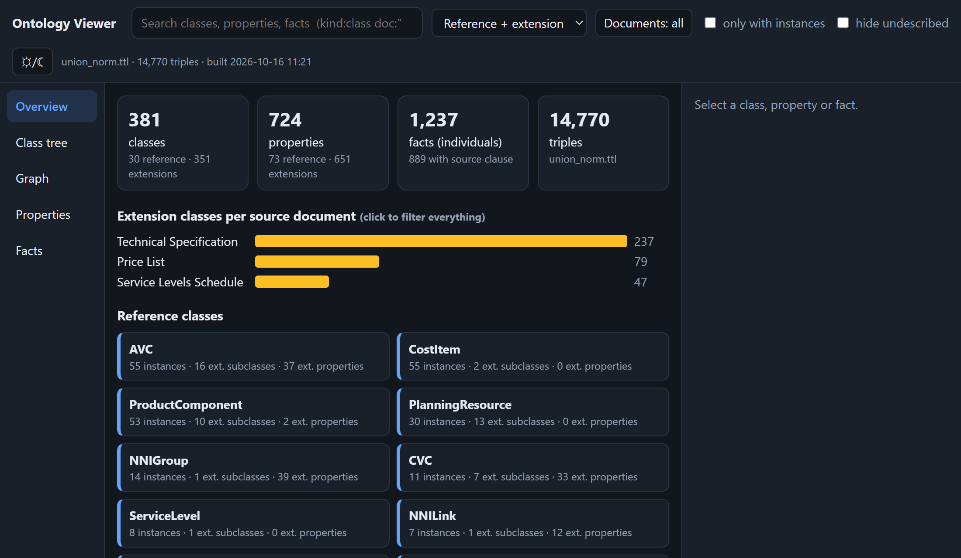
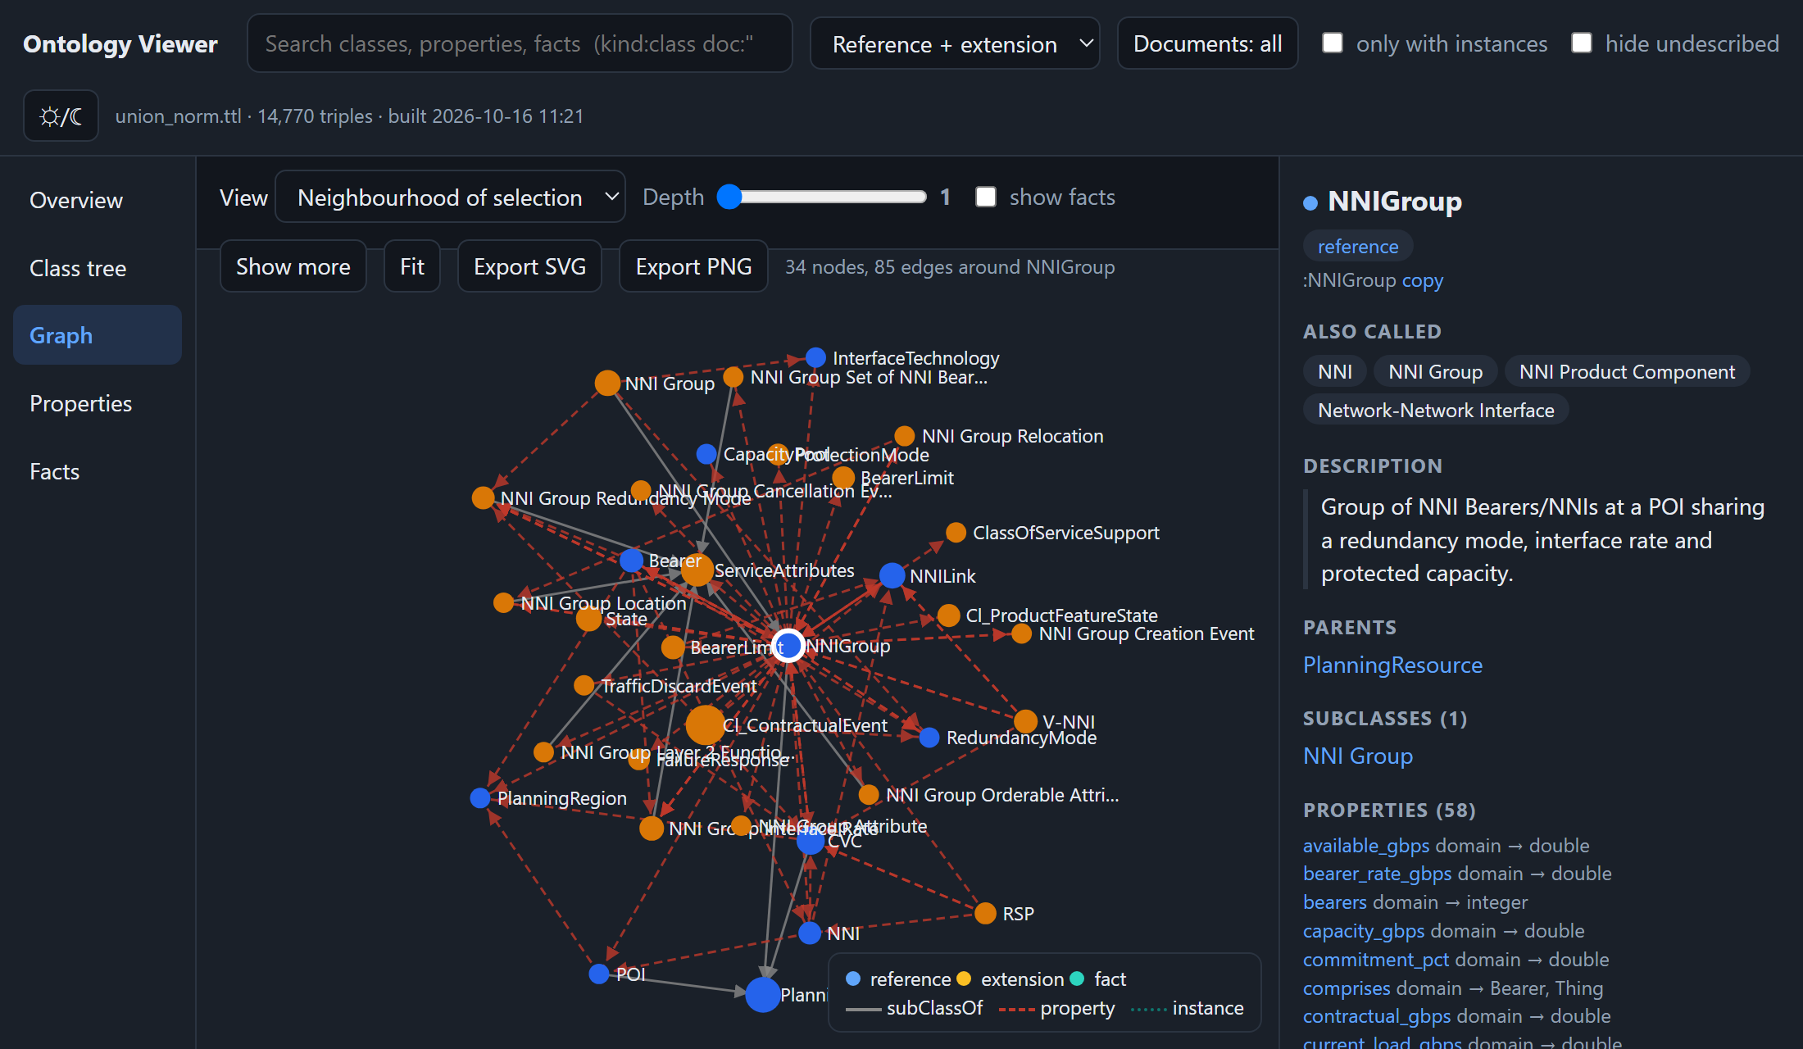
Screenshot of the system (1/2)
Overview: totals, extension classes per document, reference classes
Graph: NNIGroup (blue = Farzad's terms, orange = added from the PDFs)
What you see: an offline web page (viewer/ontology_viewer.html: one file, no server). Blue = Farzad's terms, orange = what the PDFs added. Click a class to see its properties, parents and facts.
Notes:
Screenshots are of viewer_merged.html: the four ontologies merged into one (the viewer is a single HTML file).

Slide 13
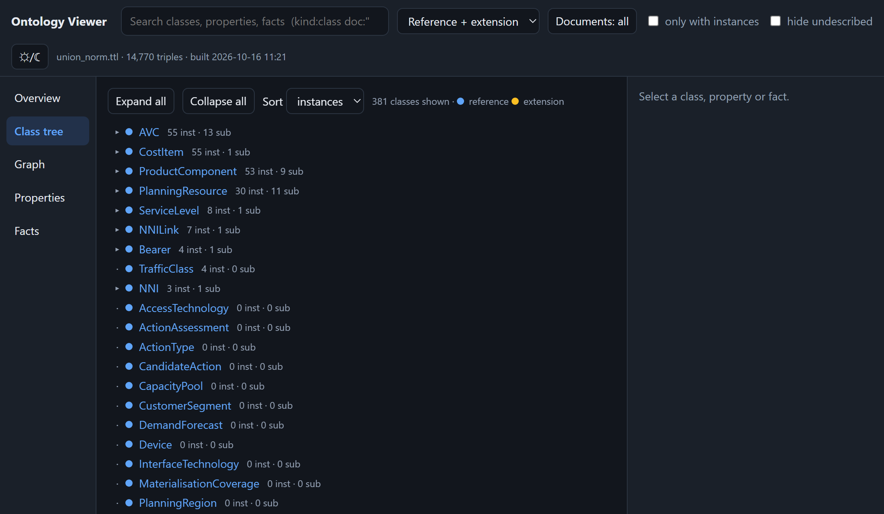
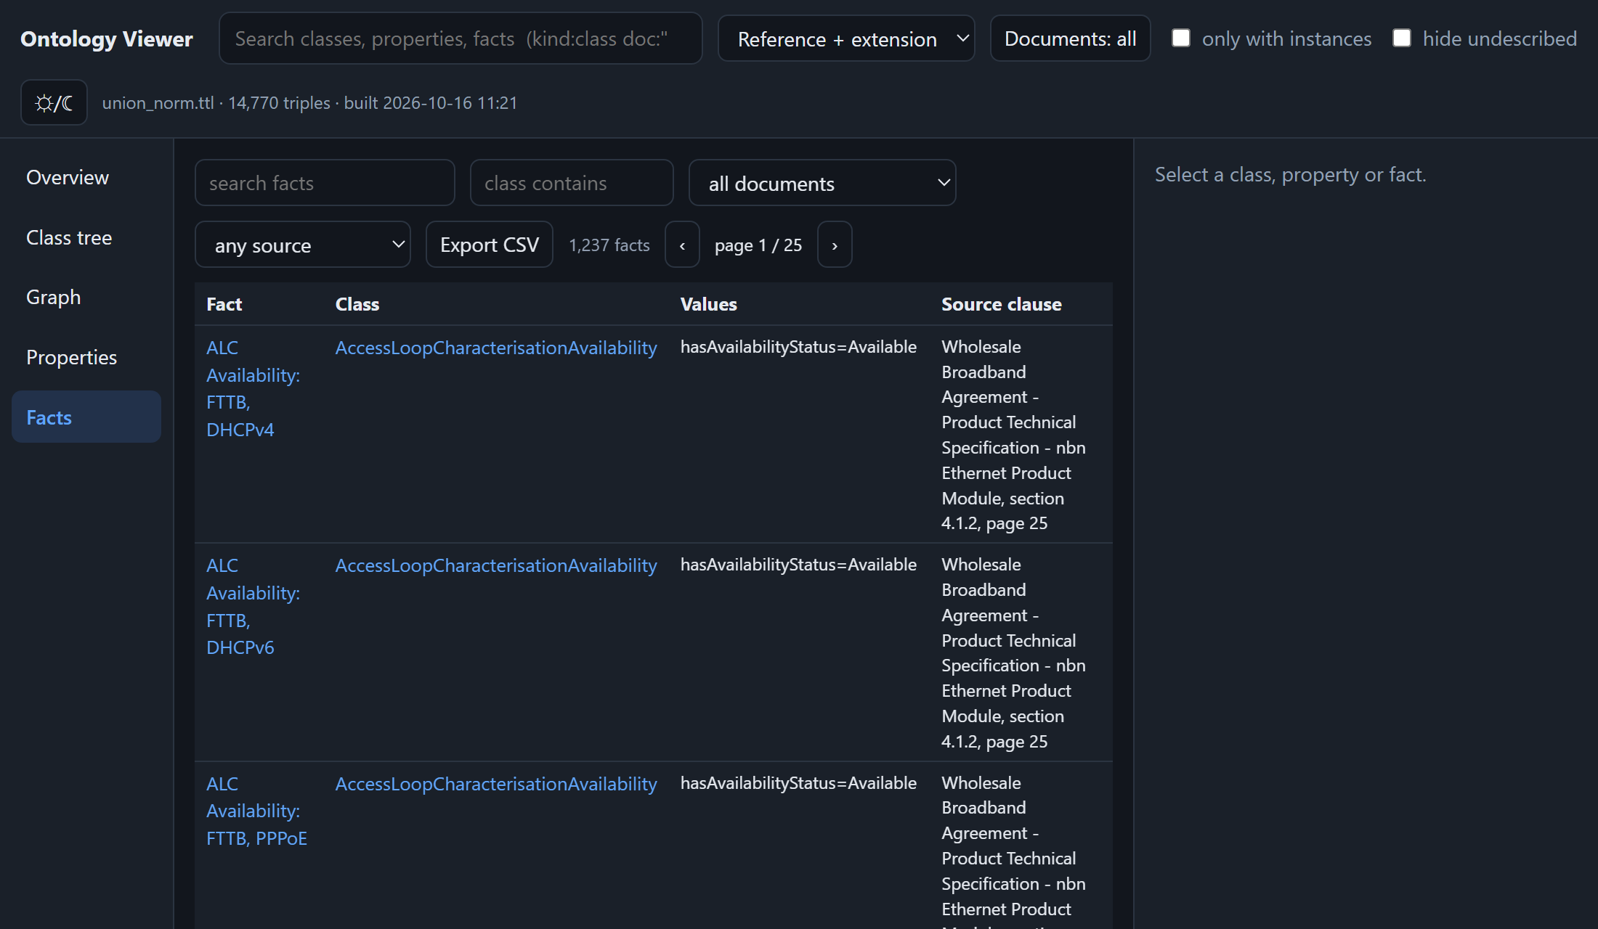
Screenshot of the system (2/2)
Class tree: reference classes first, additions below
Facts: each row names its source (document, section, page)
Why it matters: every fact can be traced back to a section and page of the PDF, and a data-quality panel lists problems (near-duplicate names, facts without a source…).

Slide 14
CQ coverage — the paper's Table 4 as bars
How to read it: same measure as the paper: an LLM writes SPARQL for each CQ, the query runs, a judge scores 0–1. “Processed” sets empty query results to 0, as the paper does. Ours: 60 CQs per document, sampled over all the pages chosen, including pages that failed (next slides split this up).
Not a blind test: those CQs were written from the same pages and given to the agents as requirements (as in the paper). Held-out reference questions (never shown to the agents, though some answers sit in the reference seed): Technical Specification 7 questions → 0.97; Service Levels 1 question → 0.00. Different documents, model and questions from the paper. The paper's RAG coverage for our ontologies is on the Table 4 slide.
Notes:
The paper has no bar chart; its Table 4 (CQ coverage) is drawn here as bars on the right. On the left is the same measure for our four ontologies. Our numbers are the pipeline's own final evaluation (agents/eval.py, 60 CQs per document, read from ontology/lite/reference/eval). If a score looks high: the questions were written from the same pages the ontology was built from, as in the paper.

Slide 15
Table 1 (paper style): the documents we used
Metric | Tech Spec | Product Desc. | Price List | Service Levels
Document (nbn Ethernet) | Product Technical Specification | Product Description | Price List | Service Levels Schedule
Version date | 2026-09-01 | 2026-09-01 | 2026-07-01 | 2026-07-01
Pages in the PDF | 84 | 32 | 22 | 50
Pages chosen | 25 | 11 | 10 | 5
Pages that made it in | 22 | 10 | 9 | 5
Words on the chosen pages | 7,436 | 4,144 | 3,405 | 2,051
CQs generated (chosen pages) | 513 | 181 | 172 | 95
Number of CQs evaluated | 60 (+7 held-out) | 60 | 60 | 60 (+1 held-out)
Same layout as the paper's Table 1 (two life-insurance contracts, about 2,000 words each, 161 and 149 CQs). Ours are four real wholesale-broadband documents; only the pages that matter most are used, and 60 sampled CQs per document are evaluated, as in the paper's SPARQL test.
Notes:
Mirrors Table 1 of the paper. Words are counted on the chosen pages only (PyMuPDF text). CQs generated = all CQs of the chosen pages; evaluated = the sample sent to the SPARQL test.

Slide 16
Table 4 (paper style): CQ coverage of our documents
Sample | Metric | Direct Generation | Multi-Agent (ours)
Tech Spec | Processed SPARQL CQ Coverage | not run | .7020
 | RAG CQ Coverage | not run | .6083
Product Desc. | Processed SPARQL CQ Coverage | not run | .8580
 | RAG CQ Coverage | not run | .5917
Price List | Processed SPARQL CQ Coverage | not run | .8200
 | RAG CQ Coverage | not run | .3417
Service Levels | Processed SPARQL CQ Coverage | not run | .8990
 | RAG CQ Coverage | not run | .7333
Same chart and table layout as the paper's Table 4. “Processed” = an empty query result counts as 0, as in the paper. We did not run the paper's direct-generation baseline, so that column is empty; RAG coverage was run on the existing ontologies (nothing was regenerated).
Notes:
Mirrors Table 4 of the paper (Sample / Metric / Direct Generation / Multi-Agent). Our SPARQL numbers are the pipeline's own final evaluation (60 CQs per document, empty query results set to 0). Direct generation was not run by us, so the column is empty rather than estimated.

Slide 17
Numbers 1/3 — how well are the questions answered?
Take-away
If a question's page is in the ontology, it scores 0.83–0.94. If the page failed, it drops: Tech Spec questions on failed pages score only 0.09. So most of the lost score is missing pages, not wrong modelling.
Take-away
186 of 240 sampled questions are fully correct (78%), 21 partly, 33 wrong or without an answer. Held-out reference questions (number → score): Tech Spec 7 → 0.97; Service Levels 1 → 0.00.
Notes:
Score = the paper's SPARQL + judge test, 'processed' (an empty query result counts as 0). Source: ontology/lite/reference/eval/*.json. Each CQ is matched to its PDF page through the CQ files (CQ page keys are 0-based, PDF pages 1-based).

Slide 18
Numbers 2/3 — how much was built?
Take-away
46 of the 51 chosen pages made it into the ontology (90%). The chosen pages are only 51 of the 188 pages in these four documents: the ones that mention NNI Group, CVC, AVC, bearers and service levels most.
Take-away
Merged (a term found in two documents counted once): 351 new classes, 651 new properties, 1239 facts, on top of Farzad's 24 classes and 73 properties. 72% of the facts carry a source clause.
Notes:
Left: from the run logs ([added] page=N triples=K). Right: counted on the four ontology files after normalising the Price List namespace; 'new' means not part of the reference seed (24 classes, 73 properties, scope core).

Slide 19
Numbers 3/3 — what does it cost?
Take-away
A page costs more as the ontology grows, because the whole file is pasted into every prompt: median 0.4M input tokens below 2,000 triples, 0.9M above 4,000. A failed or empty page costs a median 2.5M, 4.2× a normal page.
Take-away
23% of the input tokens (9.4M of 40.5M) went on pages that produced nothing. Ontology stage only: 40.5M input and 1.29M output tokens, about $3.9 at list price (the real bill is lower: cached input is cheaper). The whole run (questions, ontologies, evaluation, retries) was 69.5M input / 1.78M output tokens in 127 minutes, about $6.65 at list price.
Notes:
Tokens are per page of the final run, taken from the [usage] lines in the run logs (they are cumulative per process, so the script subtracts). Input tokens dominate because every agent call carries the whole ontology (the paper's design). List price: $0.091 per million input, $0.182 per million output tokens (DeepSeek V4 Flash on OpenRouter). Failed or empty pages are the ones where repair rounds kept running.

Slide 20
Known problems and next steps
Price List is in another namespace
Its file uses a different namespace from the other three (cause not traced). The logs show the source-clause check flagging its :sourceClause values as “unsupported”, and only ~20% of its facts still have one. Its AVC, CVC… copies also count as duplicates. Fix: re-run it, or re-write the namespace and add the clauses back.
Duplicates
32 near-duplicate class pairs (Cl_AVC vs AVC). The model invents a variant instead of reusing. The paper reports the same weakness.
Some pages are missing
Pages 32, 41, 51 (Tech Spec); 9 (Product Desc.); 8 (Price List) failed or added nothing. Questions about those pages score far lower (Tech Spec 0.09, Product Desc. 0.55, Price List 0.79).
Test questions are not fully blind
One policy example leaked a value (fixed) and a few reference values sit in the seed, so the 8 held-out questions are only partly clean.
Small evaluation
60 CQs per document, one run, one judge model, questions from the same pages the ontology was built from. No direct-baseline comparison.
Notes:
Honest list. Each of these is visible in the files, none is hidden.

